Slide 1

The Future of Tropical Rain Forests (IDS 2935)
Disturbance &
The Paradox of Luxuriance

Slide 2
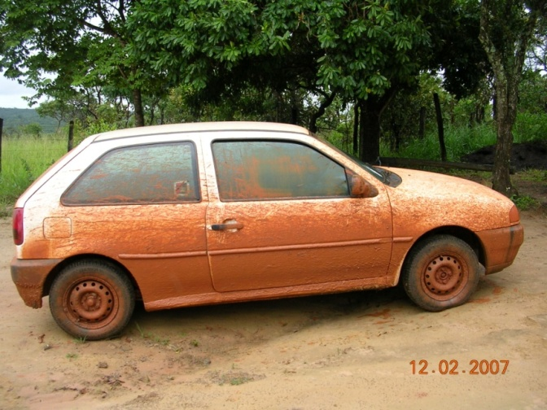
It all comes down to
SOIL

Slide 3
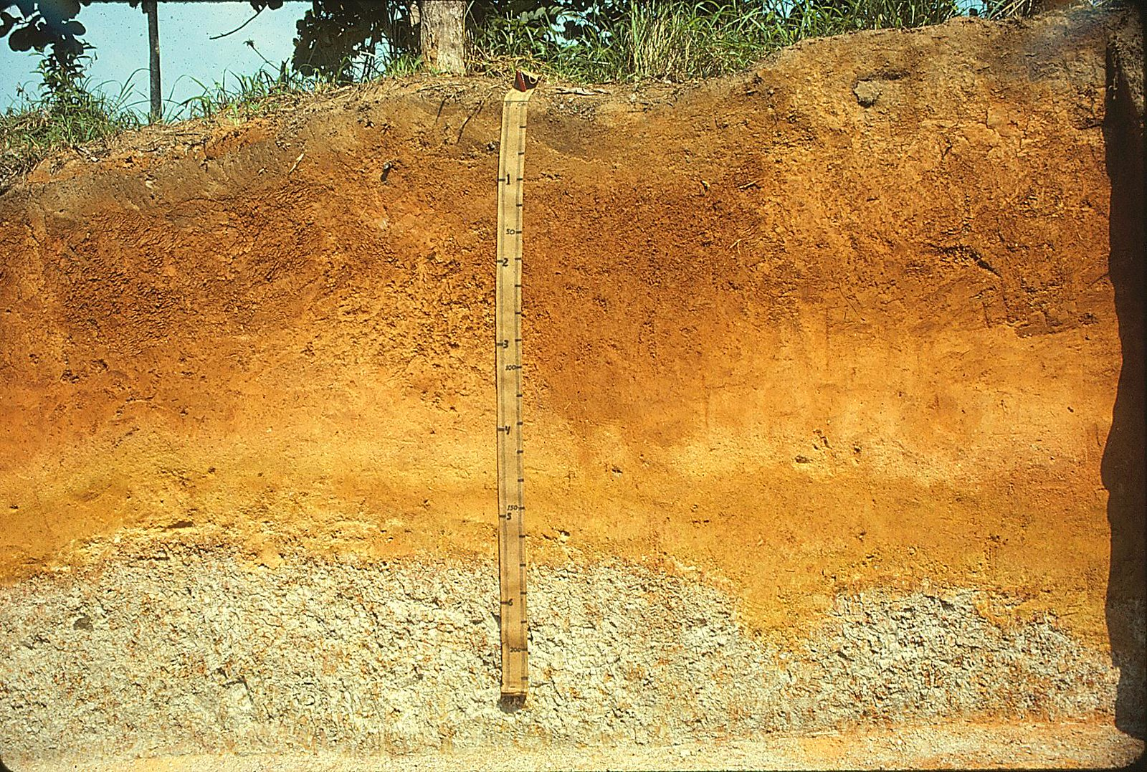
Soil
Layer of chemically and biologically altered material that overlies rock
Photo: Soil Science Typic Hapludult (fine-loamy, mixed, semiactive, isohyperthermic) In Loreto, Peru. (CC BY 2.0)
Notes:
Some people add the definition of supporting life for plants…mention recent argument over sediments and aquatic soils.

Slide 4
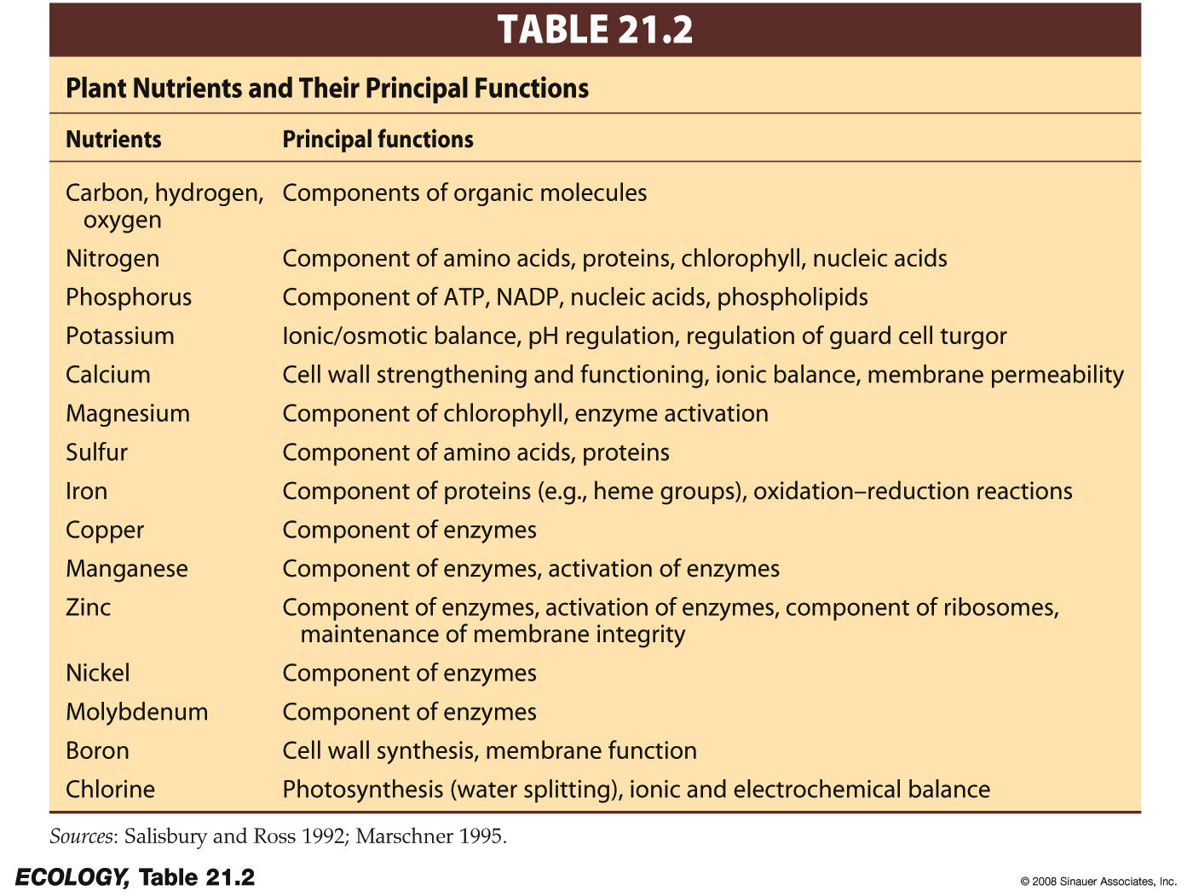
Soil Chemistry
Macronutrients: Needed in large amounts.
Micronutrients: Needed in trace amounts

Slide 5


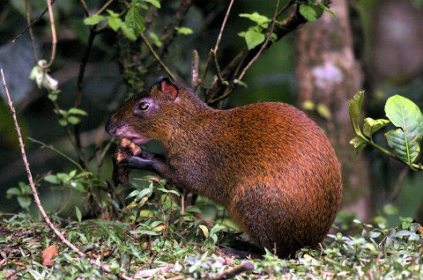
organisms at higher trophic levels get (most of) them from their food
Plants get nutrients from their environment

Slide 6
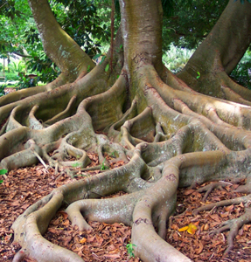
Nutrients must be present in simple, water soluble forms for plant roots to take them up
Ca²⁺
K⁺
Mg²⁺
Many of these are positively charged ions…this will be important later!
Nitrogen is the limiting nutrient in most tropical forests

Slide 7
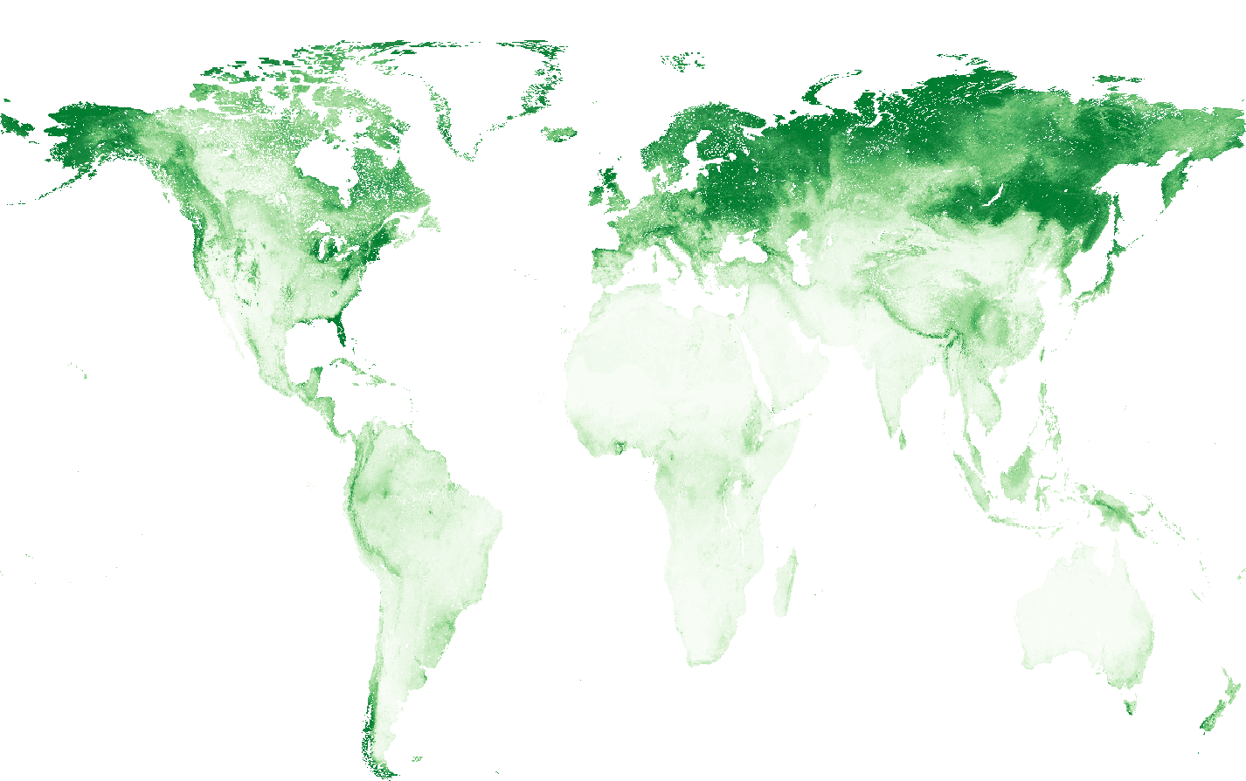
Total nitrogen
Notes:
https://data.isric.org/geonetwork/srv/api/records/f0797a68-1692-11ea-a7c0-a0481ca9e724

Slide 8
Sand
Silt
Clay
Maximum soil fertility: pH = 6.0-7.2.
Below about pH 5.5…nutrients leach out of the soil.

Slide 9
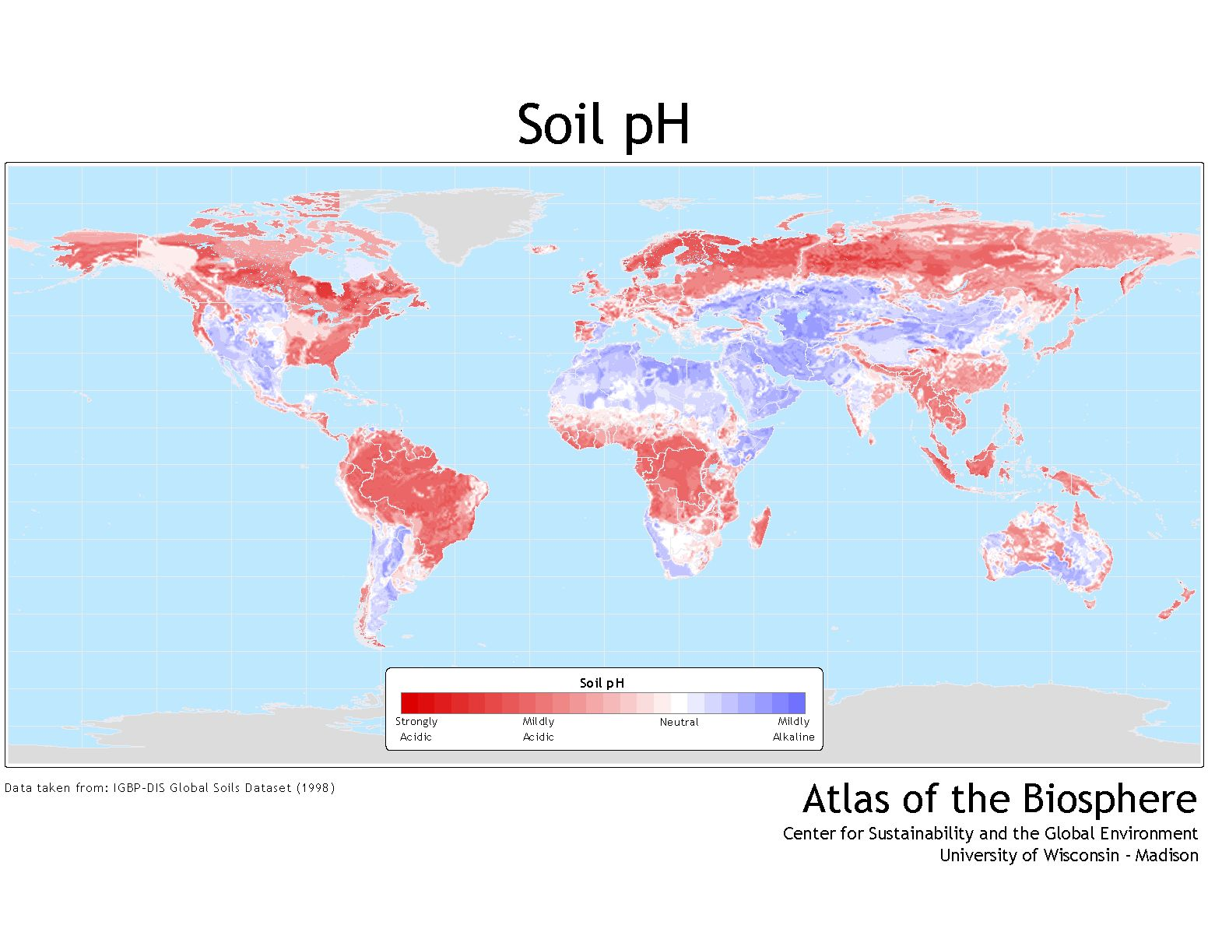
“Typical” tropical soil pH = 4.2-5.0

Slide 10

So if tropical soils are so terrible, where did all this productivity come from?
© copyright by Johnathan Esper

Slide 11
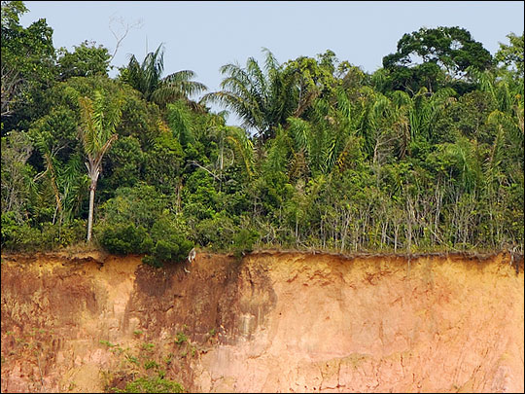
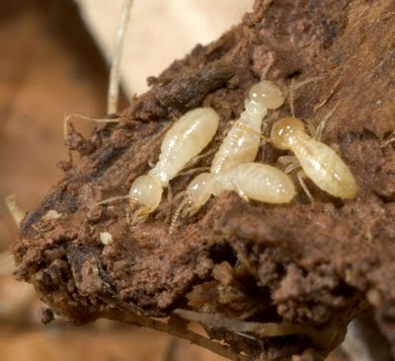
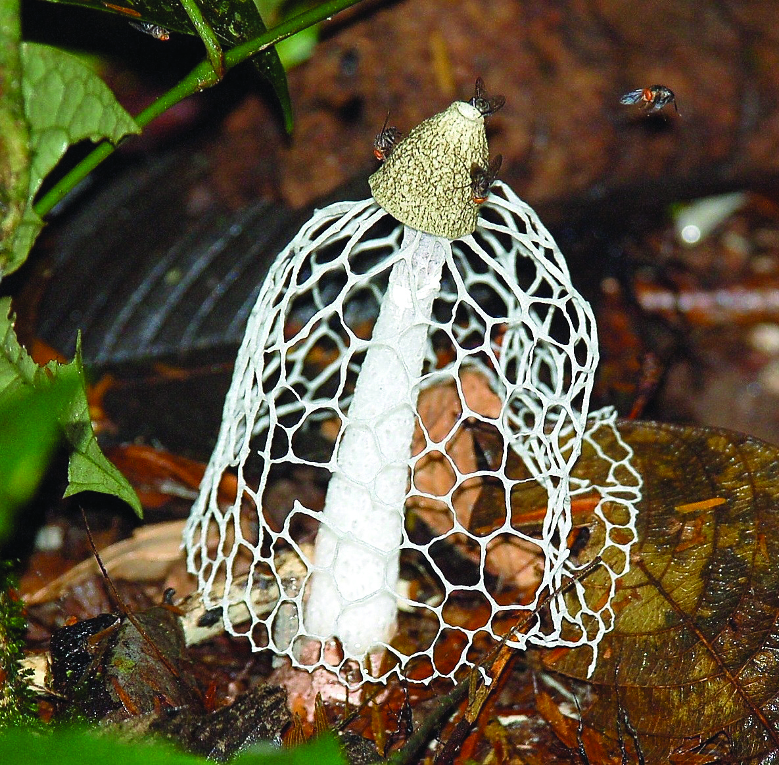
Most of the nutrients in Tropical Rain Forests are in the living (tree) biomass.

Slide 12
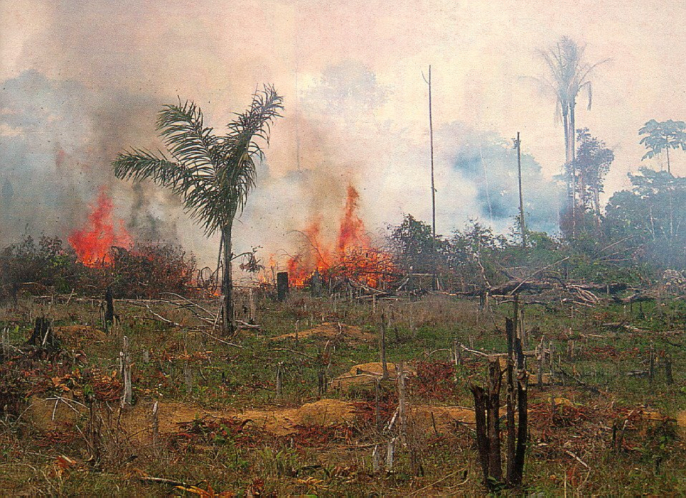
When tropical forests are cleared and burned, most nutrients are lost in smoke and ash and soil erosion.
If severe enough, these ecosystems can take centuries to return to their previous state.

Slide 13

Photo by Feria de Productores: Maíz / Milpa
Tangamandapio, Michoacán (CC BY 2.0)

Slide 14
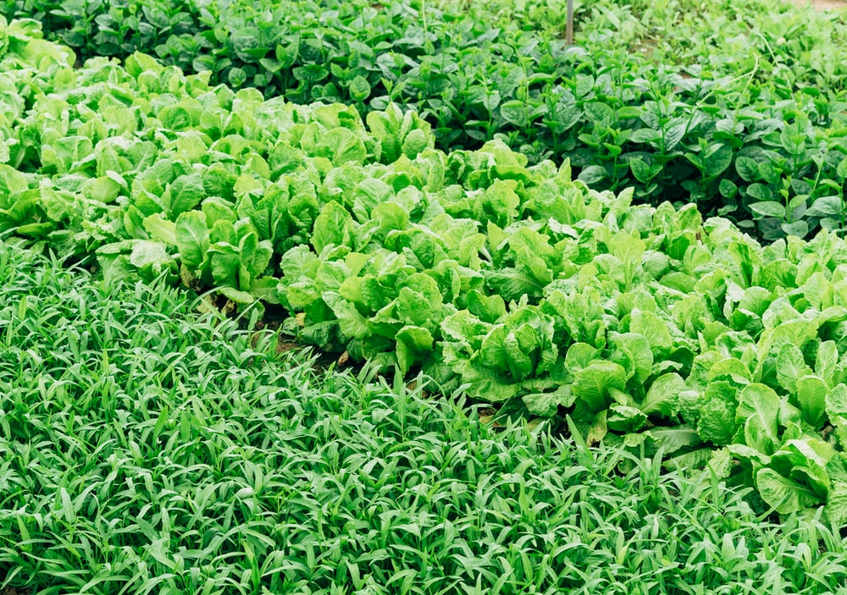
John Terborgh called this
“The Paradox of Luxuriance”

Slide 15
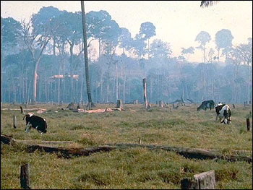
John Terborgh called this
“The Paradox of Luxuriance”

Slide 16
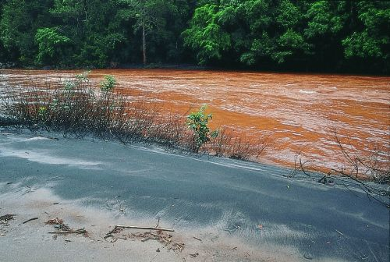
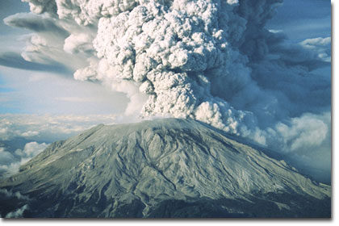
How do nutrients get back into the soils?
Rain
Exposure of new parent material
River deposits
Volcanoes
Outer space
Nutrient Cycling / Decomposition

Slide 17
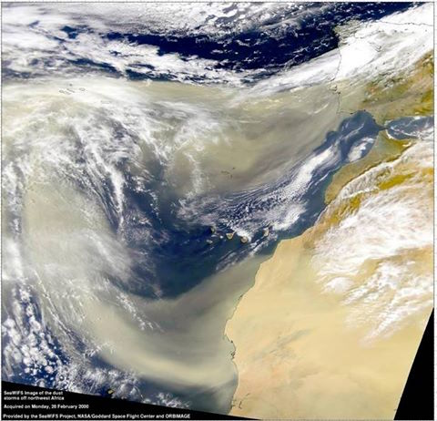

Slide 18
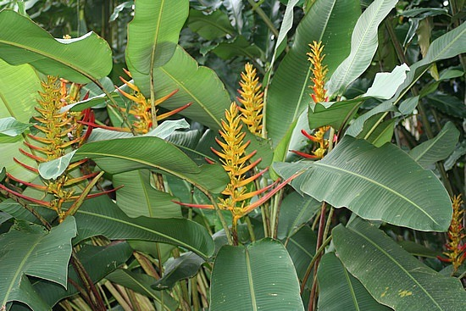
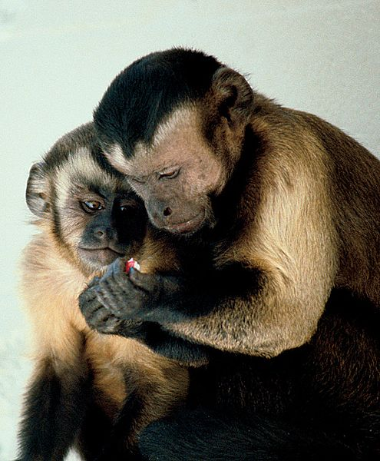
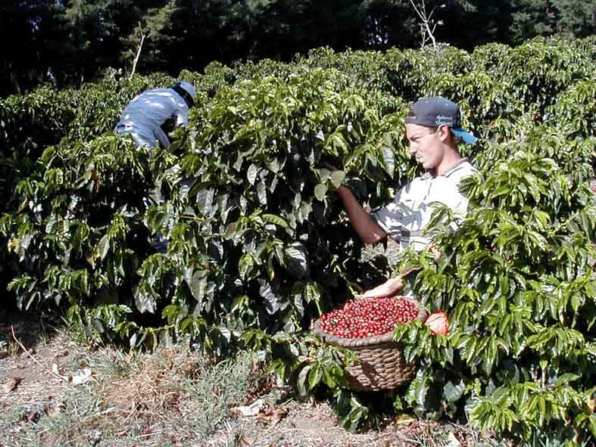
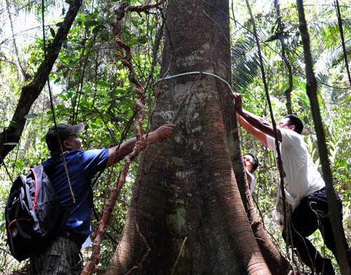
Variability in soil quality has major ecological impacts
Plant fertility
Animal abundance,
Home range sizes,
Human settlement and agriculture
Forest biomass

Slide 20
Three key properties of soil:
TEXTURE
WATER RETENTION CAPACITY
CHEMISTRY
1) Texture: size distribution of mineral particles
Sand
Silt
Clay
2 - 0.5 mm
0.002 - 0.5 mm
<0.002 mm

Slide 21
1) Texture: size distribution of mineral particles
Sand
Silt
Clay
2 - 0.5 mm
0.002 - 0.5 mm
<0.002 mm
Largest Ratio of SA:V
Weak negative charge attracts positively charged Ions*
Absorb water

Slide 22
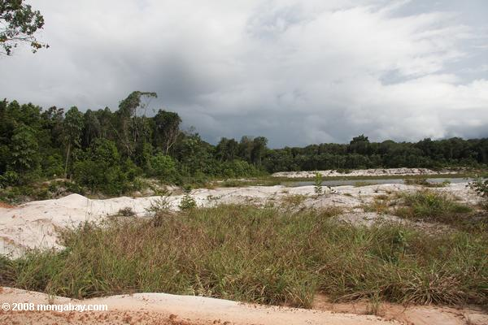
Determined by type of particles in soil & their distribution throughout the soil
2) Water Retention Capacity
Clay Soils:
Hold large volumes of water
Sandy Soils:
Drain Well
What does this mean for nutrient availability?

Slide 23
3) Soil Chemistry: soil pH strongly influences nutrient availability
pH: large concentration of H⁺ (acidic)
pH: low concentration of H⁺ (Basic or alkaline)
Clay
-
H⁺
K⁺
A little acidity promotes nutrient availability. How?
Below about pH 5.5…nutrients leach out of the soil. Maximum soil fertility: pH = 6.0-7.2

